Slide 1
Wiltshire Cricket Grounds Association
Annual General Meeting
Sunday 1st February 2026
Venue: Corsham Cricket Club
Corsham.

Slide 2
ANNUAL GENERAL MEETING OF THE WILTSHIRE CRICKET GROUNDS ASSOCIATION
AGENDA FOR 2026
Registration. Tea /Coffee 10:00 – 10:15am
Apologies.
AGM minutes 2025 / Matters Arising / treasurer / election of officers
Chairmans report.
Treasurers report.
Election of Officers. minutes
Pete Sykes MD, WC Ltd. & Richard Mosdell Wilts PA
A O B.
Tea / Coffee Break
Guest Speaker: Nick Pepper. Head Groundsman Somerset CCC.

Slide 3
Chairmans Report
• Welcome
• Speakers
• Pitch Marks
• Training Sessions
• Renovations
• Grass Pitch Improvement Fund – PitchPower App
• Forward Look
• Thanks

Slide 4
Opening Balance as @ 30/09/2024 |  |  |  |  |  | £9,841.75 | £
Income
End of season Renovations plus sundries paid to date |  | : |  |  |  | £7,320.00
Total brought forward |  |  |  |  |  |  | £17,161.75
Outgoings
Brought forward from Journal
Outgoings |  |  |  |  |  | £8,614.49
 |  |  |  |  |  |  | £8,614.49
 |  |  |  |  |  |  | £8547.26
Closing Bank balance – CF as @ 06/01/2026 |  |  |  |  |  |  | £8,267.85

Slide 5
TREASURERS FORCAST:
The treasurer wishes to report, that income from 1 club, is still outstanding due to late invoicing etc, (£ 400.00)

Slide 6
ELECTION OF OFFICERS :
The Chairman to ask the members if any member present would wish to stand for office in any of the roles listed :-
Chairman : P Jackson : Will stand if Re - Elected
Vice Chairman : M Smith: Will stand if Re - Elected
Secretary : G Clift : Will stand for one more year if Re - Elected
Treasurer : Andrew Short : Will stand if Re - Elected
WGA Board Representative : J Wilkins : Will stand if Re – Elected
A O B :
MEETING CLOSED :

Slide 7

Wiltshire Cricket
WCGA AGM January 2026

Slide 8

2020-2024
Driving Cricket’s Future
First ever CPA
……….
Significant growth and increase in breadth of our work
Big focus on compliance with CPA 1.0 standards
……….
CPA 2.0 and our 2025 – 2028 strategy represents an opportunity to further evolve and define what Wiltshire Cricket is here to do

Slide 9
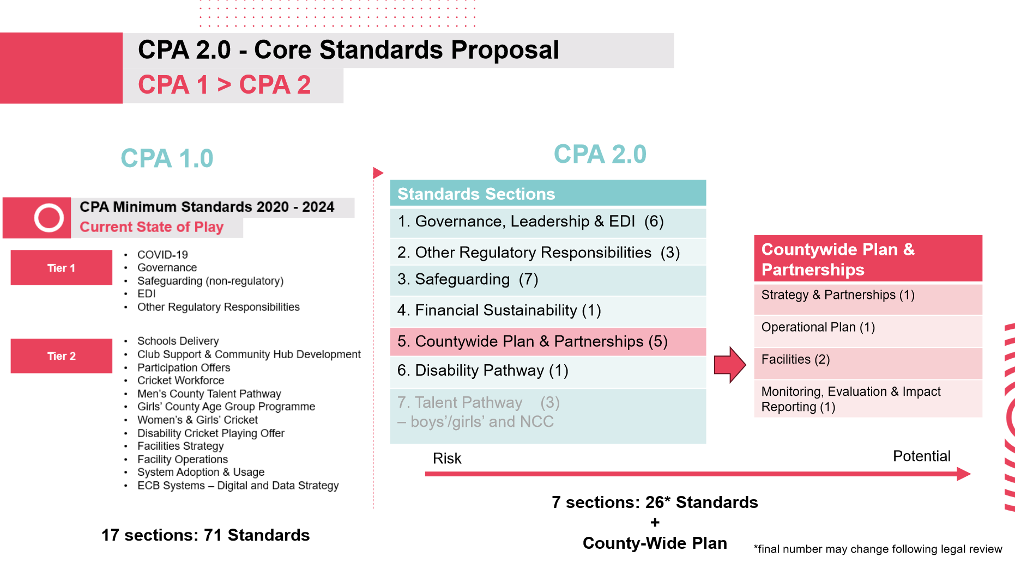

Slide 10
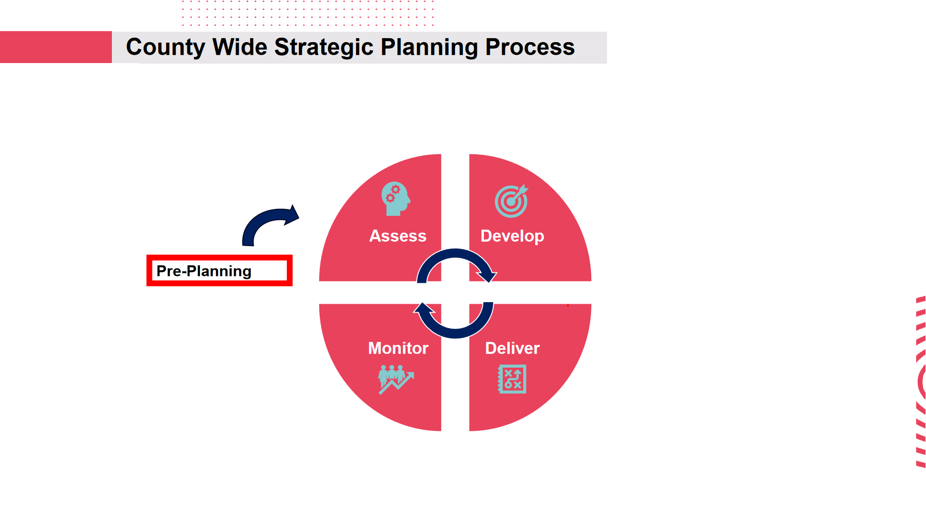

Slide 11

What can you expect in the Assess phase?
Collection of quantitative data across your work areas
Surveys to seek feedback from our stakeholders
Focus groups to gather qualitative feedback
Collection of quantitative and qualitative data to help us to baseline and benchmark where we are
A need to be humble and a willingness to listen to feedback that will help to make Wiltshire Cricket even better
Imagine this was your first day in your role. What would you want to know?

Slide 12
What can you expect in the Develop phase?
Internal staff and Board member workshops to start identifying our mission and vision statements
External testing of those mission and vision statements
Development of clearly defined objectives, to help us answer the question of why we do what we do
Development of our company values

Slide 13

Progress to Date

Slide 14

Progress to Date

Slide 15

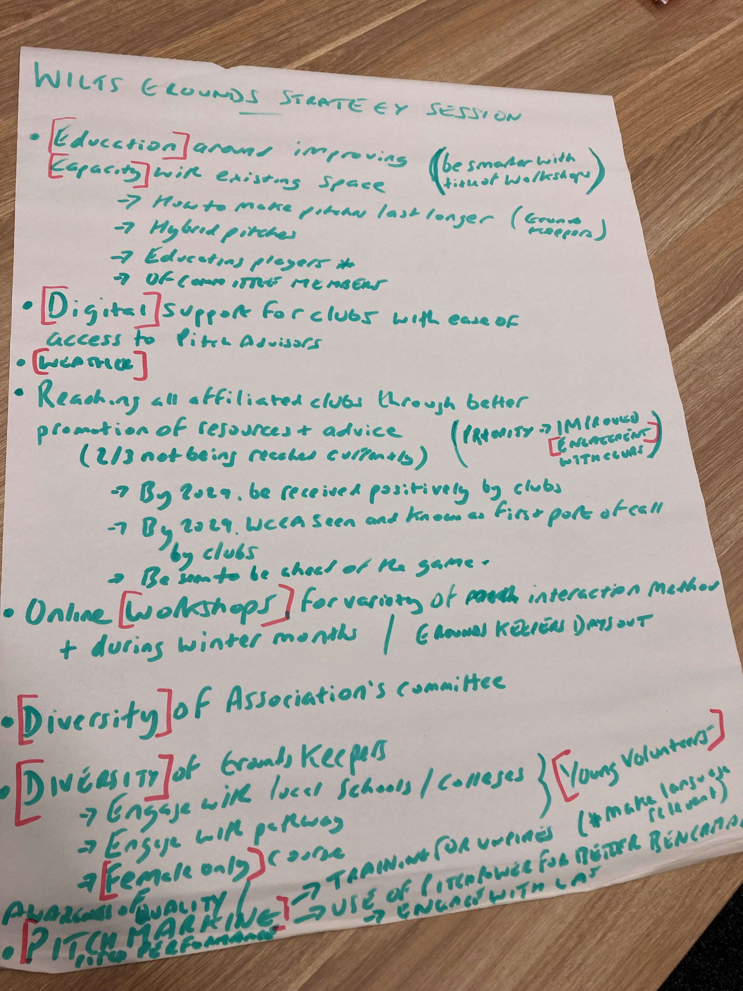
Progress to Date

Slide 16
Draft Strategic Themes - Grounds
Theme 1: Innovative Education:
Theme 2: Digital support for Grounds volunteers:
Theme 3: Weather:
Theme 4: Increased and improved engagement with affiliated clubs
Theme 5: Workshops:
Theme 6: Engage a broader demographic of Grounds volunteers:
Theme 7: Pitch Marking and Pitch Power:
Theme 8: Engagement with Local Authorities:
Theme 9: Renovations and Trailer

